Slide 1
On some contact-induced features of the
Mishar Tatar dialects
Arman Eleusin, Goethe University frankfurt

Slide 2
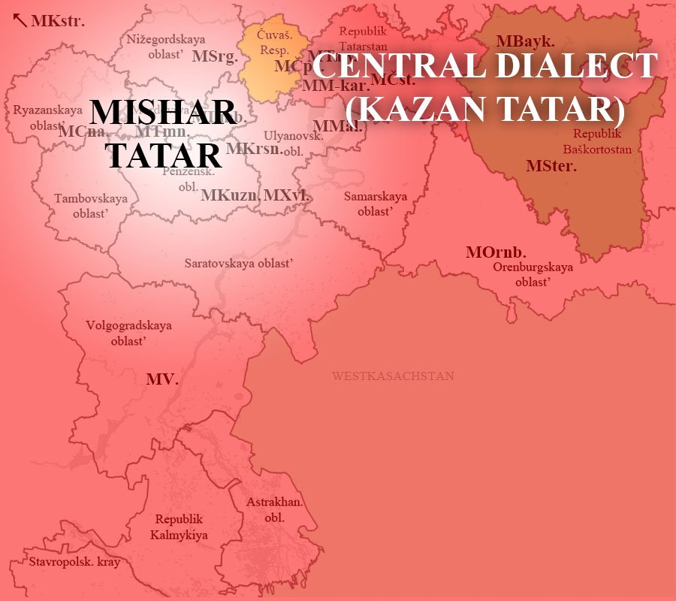
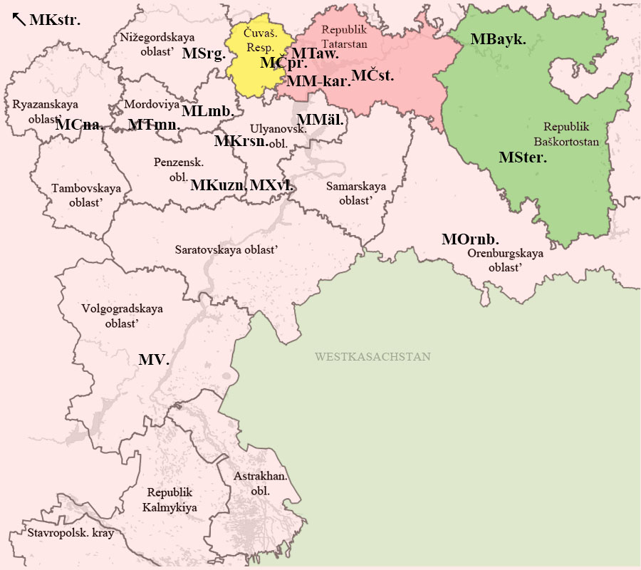
CONTACT AREAS

Slide 3
THE IMPACT OF THE KAZAN TATAR
ON THE MISHAR DIALECTS
PHONOLOGY

Slide 4
THE IMPACT OF THE KAZAN TATAR
ON THE MISHAR DIALECTS
Full raising of the vowel phonemes in the east:
In MSrg.: [or.ˈman] “forest”, [boɫ] “to be, to become”,
[ø̝r.ˈdæk] “duck”, [b^{i}er] „to give“
“ORIGIN” | “EAST” | Translation
[tuºk.ˈta] | [tuk.ˈta] | to stop
[juºɫ.ˈdaʃ] | [juɫ.ˈdaʃ] | comrade
[ky^{ø}p] | [kyp] | much, many
[by^{ø}.ˈrĭ] | [by.ˈrĭ] | wolf

Slide 5
THE IMPACT OF THE KAZAN TATAR
ON THE MISHAR DIALECTS
Adoption of the phoneme /ɡ/ ([ʁ] in Standard Tatar) for the borrowings of Arabic/Persian origin instead of 'ayn:
“ORIGIN” | “EAST” | Translation
ayïp | gayĭp | guilt
ümĭr | gǚmĭr | life
säät | sägät | hour, clock
alim | galim | scientist
näwmät | nigmät | nutriment
dïwa | dïga | invocation

Slide 6
THE IMPACT OF THE KAZAN TATAR
ON THE MISHAR DIALECTS
Realisation of the sound sequence */üy/ as /iy/ instead of /ü/:
“ORIGIN” | “EAST” | Translation
ü | iy | house
üdä | iydä | at home
süläp | siyläp | talking
süwäk | siyäk | bone
tümä | tiymä | button
ülän- | iylän- | to get married

Slide 7
THE IMPACT OF THE KAZAN TATAR
ON THE MISHAR DIALECTS
Realisation of the preterite copula idĭ as iyĭ, ïyï:
Emergence of the uvular allophones of /k/ and /ɡ/ in MSter. (+ partly in MV.): “ORIGIN” [kar.ˈɡa] vs. MSter. [qar.ˈʁa]
“ORIGIN” | “EAST” | Translation
idĭ | iyĭ, ïyï; yĭ, yï | was/were
utïra idĭk | utïrabïz ïyï | We were sitting.
kïzïm dürt yäštä idĭ | kïzïm dürt yäštä iyĭ | My daughter was four years old.

Slide 8
THE IMPACT OF THE KAZAN TATAR
ON THE MISHAR DIALECTS
MORPHOLOGY

Slide 9
DISAPPEARING OF SOME STRUCTURES TYPICAL OF THE WESTERN MISHAR DIALECTS:
Cliticons/Suffixes after imperative forms:
-čI (to express a polite request) is replaced by älĭ of the Central Dialect,
kil čĭ ~ kil älĭ “come (please)”
-gIn (to enhance/emphasise the request/order)
    bĭzgä bakmagïn, aša “Don’t look at us, eat”
Verbal suffix -Ip for expressing mirativity and evidentiality:
ïnïtïpmïn “I must have forgotten”,
yaŋa telefon alïpsïŋ “You have bought a new telephone (mobile phone)!”

Slide 10
REPLACEMENT OF THE CAUSAL SUFFIXES:
“ORIGIN” “EAST”
-gIz
kĭrgĭz kĭrt to enter + CAUS
bĭlgĭz bĭlgĭrt to know + CAUS
yatkïz yatkïr to lie + CAUS
yĭtkĭz yitkĭr to reach + CAUS
-gAz:
kürgäz kürsät to see + CAUS (to show)
ütkäz ütkär to pass + CAUS

Slide 11
THE ADOPTION OF THE CONVERB -sIngA
AND THE FUTURE PARTICIPLE -sI
-sIngA expresses the purpose of an action and is also found in the dialects of Central Tatar (e.g. Baltač dialect):
bäräŋgĭ üssĭngä su sibäbĭz “So that potato grows, we pour water”
-sI:
ällä tiz kitäsĭ kunaklar sĭz?
“Or you are guests who will quickly go away?” (MSter.)
kil älĭ, siŋa atʲasï süzĭm bar
“Come here (please), I have a word to tell you” (MOrnb.).

Slide 12
THE ADOPTION OF THE IMPERATIVE SUFFIX -(I)ŋ
FOR THE SECOND PERSON PLURAL
OR SINGULAR POLITE FORM IN MBayk.
cäy ĭcärgä kĭrĭŋ, kïzlar
“Go inside to drink tea, girls!”
yatasïgïz kilsä, yatïb alïŋ
“If you want to lie down, lie down (have a nap)”

Slide 13
MIXING UP OF TWO TYPES FOR THE EXPRESSION OF DESIRE
TO PERFORM AN ACTION
“ORIGIN” “EAST” (< KAZAN TATAR)
-gI+POSS + kĭlä- -sI+POSS + kil-
kaya bargïŋ kĭliy kaya barasïŋ kilä Where do you want to go?
yĭbärgĭbĭz kĭlämiy yibäräsĭbĭz kilmiy We don’t want to send it
ügä katʲkïm kĭliy ügä/iygä katʲasïm kilä I want to return home
ašagïm kĭliy ašïysïm kilä I want to eat
> AsI/ysI + kĭlä- (“EAST”) cp. Kazakh: -GI+POSS + kel-
barasïŋ kĭläsä, bar barɣïŋ kelse, bar

Slide 14
THE IMPACT OF CHUVASH ON THE LANGUAGE OF KRYASHEN TATARS OF TAW YAGÏ
The language variety of the Mishar Tatar people of Taw Yagï shares morphological forms representative for Chuvash: the verbal suffixes -mAllI, -mAčIr, -As.

Slide 15
THE ADOPTION OF THE NECESSITATIVE SUFFIX -mAllI
The infinite form -mAllI (Chuvash -mAllA) serves as expression of necessity:
Nišlämällĭ? ǅïlamallï mï?
“What to do? To cry?”
urman aša gïna čïkmallï
“It is necessary to go only through the forest”
sina sägät dürttä tïrmallï (The subject is marked by dative)
“You have to wake up at 4 o'clock”
Cp. Chuvash: sanăn instituta kilmelle “You have to come to the institute”(The subject is marked by genitive)

Slide 16
THE ADOPTION OF THE NECESSITATIVE SUFFIX -mAllI
-mAllI can also be used attributively:
šakkatmallï ĭšlär buldï ĭlgärĭ
“Surprising things happened earlier”
ǆïrlamallï küw
“The song which one has to sing”

Slide 17
THE ADOPTION OF THE CONVERB SUFFIX -mAčIr
The converb -mAčIr (< Chuvash -mAsĂr) connects two events in a modifying way:
karaŋgïda kürmäčĭr yazasïn mï?
“Are you writing in the darkness without seeing”.

Slide 18
THE ADOPTION OF THE SUFFIX -As
The suffix -As can be used attributively as a future participle:
min utïras ǆirgä kuyma mamïk mĭndärnĭ
“Don't put the pillow to the place where I'll sit”
and as a verbal noun (Chuvash verbal noun -Assi):
ǆulga čïgastan kurkamsïŋ?
„Are you afraid of leaving?“
uyïn uynislar tuktiydïr
„Playing games ends“
bĭzĭn ničĭk ǆïrlisnï ishĭtkänĭŋ bar mï?
“Have you heard how we sing?”

Slide 19
Thank you for your attention!

